Slide 1
MediConnect AI
Enhancing Doctor-Patient Interactions
Objective:
• Provides doctors with AI-generated summaries of patient conversations.
• Offers patients initial diagnoses based on their symptoms.
by Krishna Sai Desaboina

Slide 2

Challenges Faced by Healthcare Providers
• Overwhelming Administrative Tasks:
• Doctors spend significant time reviewing patient histories.
• This leads to burnout and reduces the time available for direct patient care.
• Impact:
• Burnout among healthcare providers.
• Less time spent on patient care.
Notes:
https://www.mckinsey.com/industries/healthcare/our-insights/what-to-expect-in-us-healthcare-in-2024-and-beyond
https://www.washingtonpost.com › wellness › 2023/10/30

Slide 3

Challenges Faced by Patients
• Long Wait Times for Appointments:
• Patients often wait an average of 26 days for primary care.
• Resulting Issues:
• Neglected symptoms.
• Increased anxiety and delayed diagnoses.
Notes:
https://www.mckinsey.com/industries/healthcare/our-insights/what-to-expect-in-us-healthcare-in-2024-and-beyond
https://www.washingtonpost.com › wellness › 2023/10/30

Slide 4
Proposed Methodology
RAG is like an easy alternative to the Fine tunned LLMs but with a minute compromise on accuracy Advantages: Easy to Implement, requires less computational power and time.

Slide 5
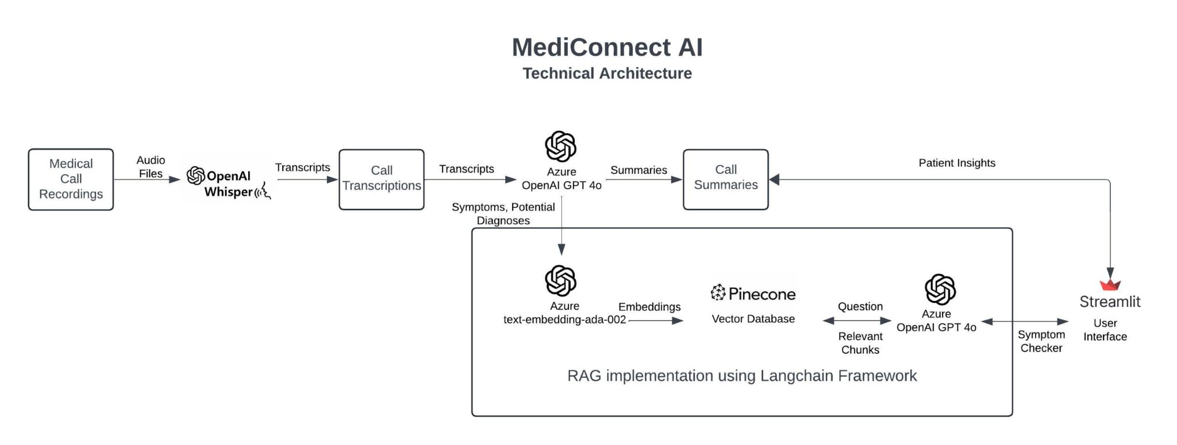
Architecture

Slide 6
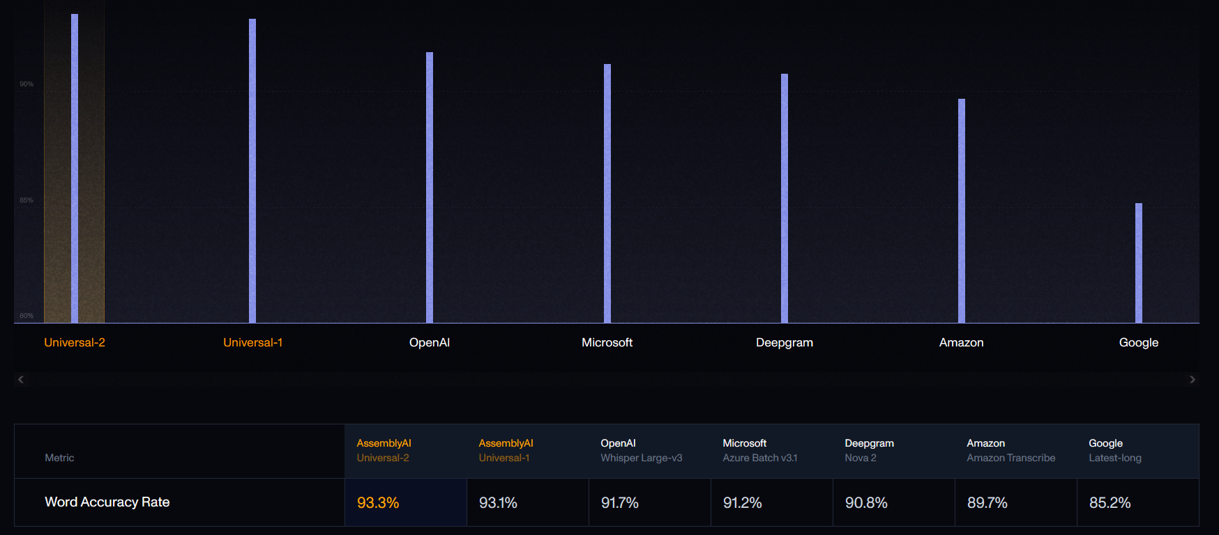
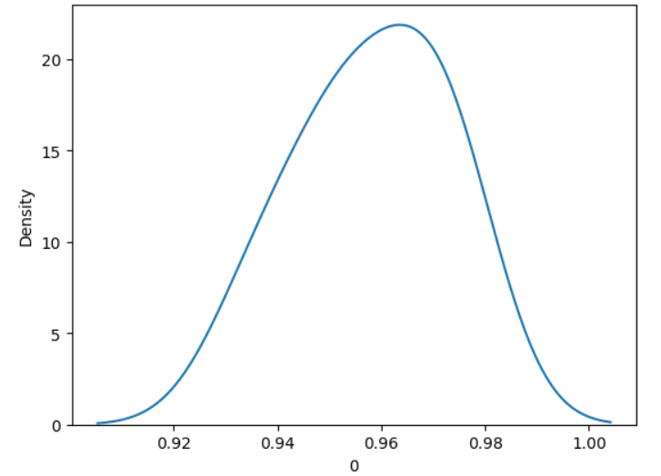
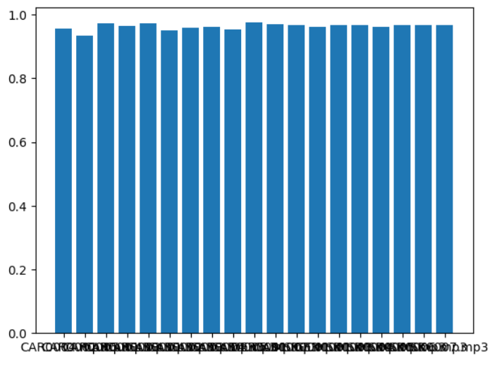
Hypothesis Testing:

Slide 7
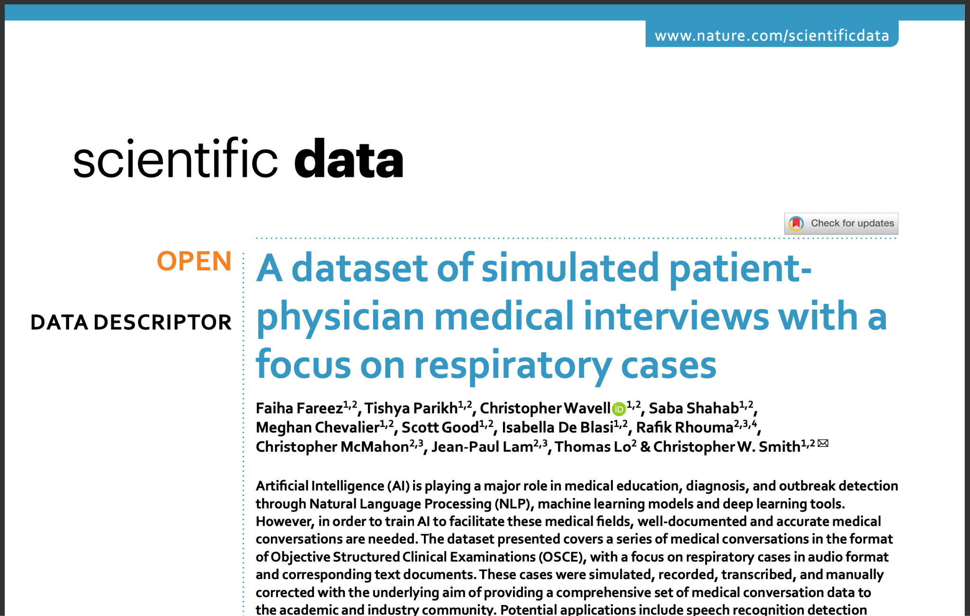
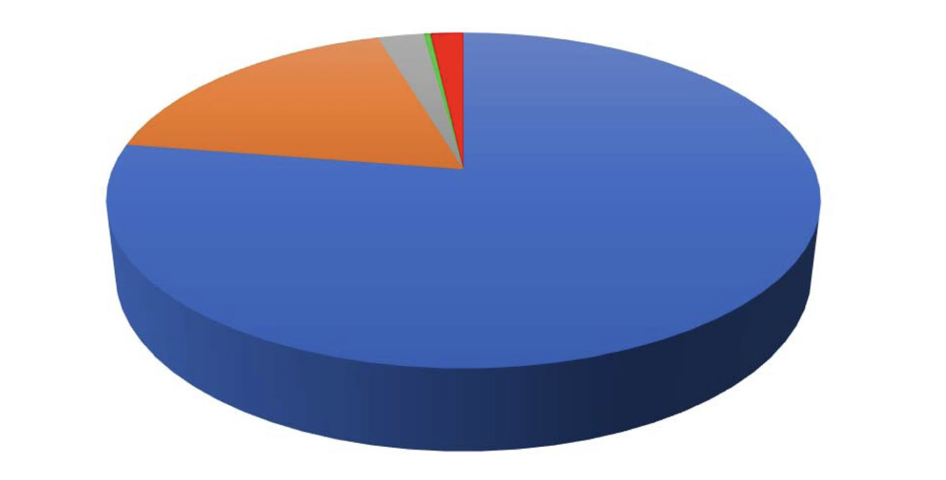
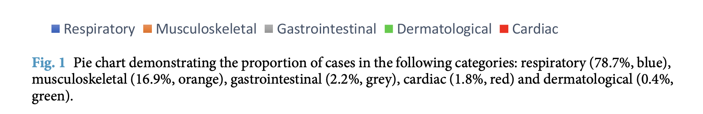
Data Source
A dataset of simulated patient-physician medical interviews with a focus on respiratory cases | Scientific Data

Slide 8
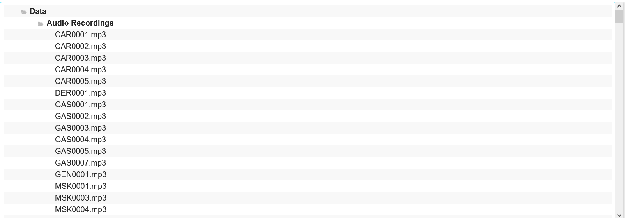
Data Set:
Notes:
Medical Call Recordings: The process begins with recorded patient-provider conversations.
OpenAI Whisper: These audio files are transcribed into text using Whisper.
Call Transcriptions: The transcriptions are then processed to generate summaries and extract key medical insights.
Azure OpenAI GPT-4: The GPT-4 model is utilized to create structured summaries from the transcriptions, which include symptoms discussed, potential diagnoses, and follow-up actions.
Call Summaries: Summarized conversations are stored and can be accessed by healthcare providers under the Patient Insights feature.
RAG Implementation: The platform integrates Retrieval-Augmented Generation (RAG) using the Langchain Framework, Pinecone vector database, and Azure embeddings. This combination allows the platform to answer patient queries based on previous data.
Symptom Checker: Patients can use the Symptom Checker feature to receive an initial diagnosis based on their symptoms.
Streamlit Interface: Both the Patient Insights and Symptom Checker features are accessible through a user-friendly Streamlit interface.

Slide 9

MediConnect AI: Patient Insights
Feature:
Automatically records and summarizes
past patient conversations.
Benefit:
Allows doctors to quickly review key information before appointments.
Reduces administrative burden and enhances focus on patient care.
Notes:
Who They Are: Doctors, general practitioners, and specialists who need efficient tools to manage patient information.
Their Need: Simplified access to comprehensive patient summaries to improve decision-making and reduce time spent on administrative tasks.

Slide 10

MediConnect AI: Symptom Checker
Feature:
Provides patients with an initial diagnosis based on their symptoms.
Benefit:
Helps patients manage their health while waiting for a doctor’s visit.
Encourages timely consultation with healthcare professionals.

Slide 11
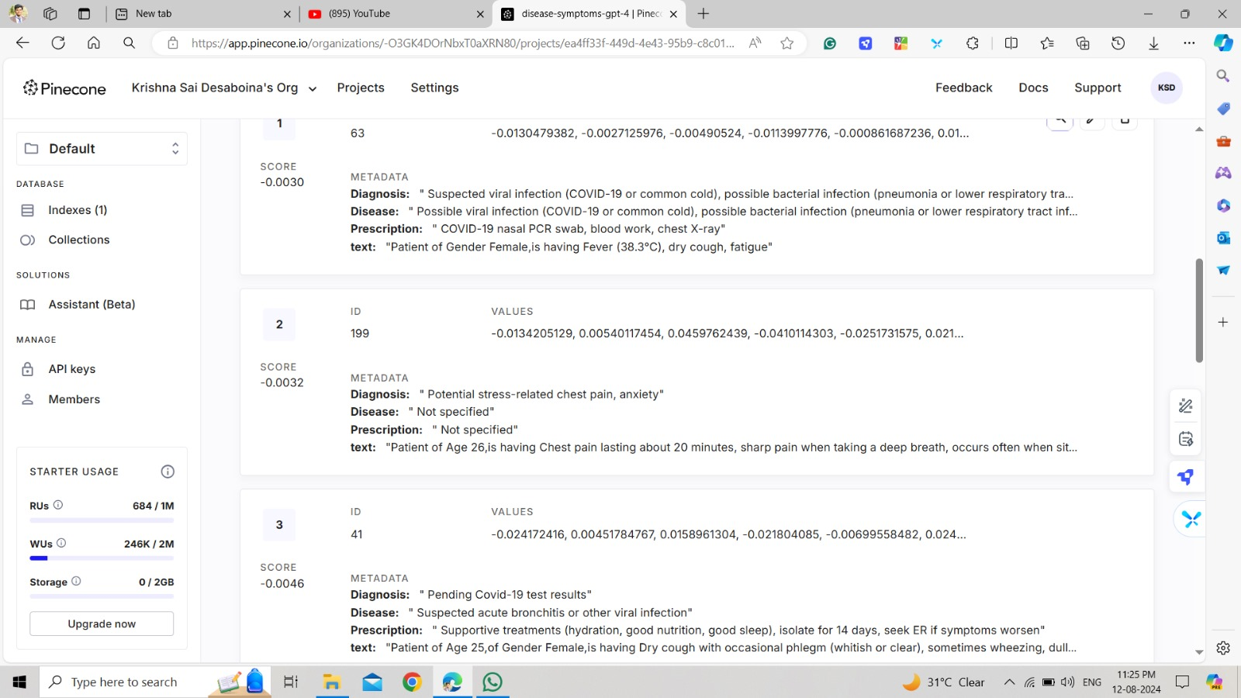
PineCone Vector Database

Slide 12
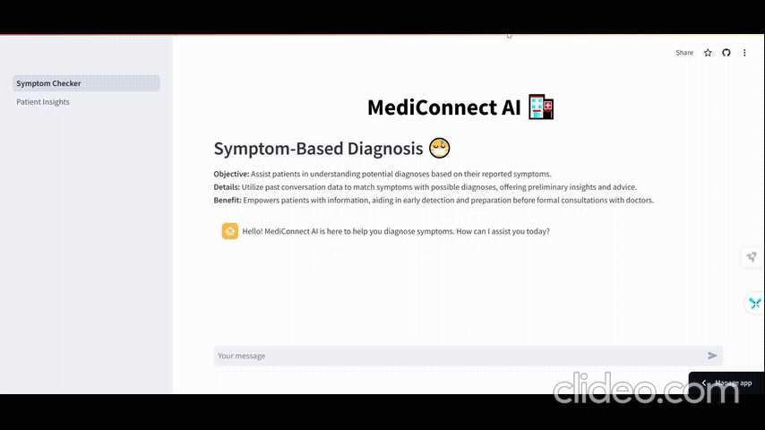
Symptom Checker

Slide 13

Patient Insights

Slide 14
MediConnect AI · Streamlit
Demo
We have uploaded the App to Streamlit cloud
You can use the below link to use the App.
https://mediconnectai.streamlit.app/

Slide 15
References: Fareez, F., Parikh, T., Wavell, C. et al. A dataset of simulated patient-physician medical interviews with a focus on respiratory cases. Sci Data 9, 313 (2022). https://doi.org/10.1038/s41597-022-01423-1 https://springernature.figshare.com/articles/dataset/Collection_of_simulated_medical_exams/16550013

